Slide 1

Yelp Sentiment Analyzer
An end-to-end Streamlit web application for real-time and batch sentiment analysis of customer reviews using ensemble machine learning techniques.

Slide 2
Project Overview
Understanding the architecture and objectives of the Yelp Review Sentiment Classification system.

Slide 3

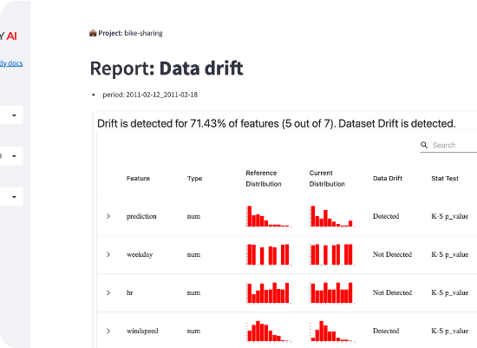
Powered by Streamlit
Modern Web Interface
→
Reactive UI: Instant feedback during review analysis and model training.
→
Multi-tab Navigation: Seamlessly move between data exploration, model training, and predictions.
→
Scalable Backend: Optimized Python integration for heavy NLP feature extraction.

Slide 4
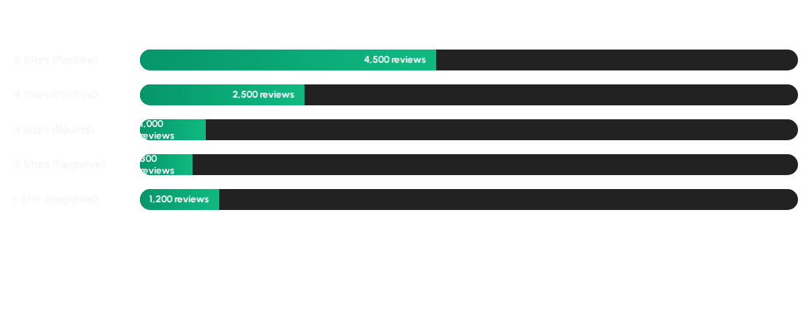
Dataset Distribution
Mapping: 1-2 Stars → Negative | 3 Stars → Neutral | 4-5 Stars → Positive

Slide 5





Feature Engineering
TF-IDF Bigrams
Linguistic Signals
Lexicon Scoring
Capturing local context and word pairs to understand phrases like "not good" or "very tasty".
Handcrafted features including punctuation density, caps usage, and sentence length statistics.
Integrating domain-specific sentiment lexicons to calculate overall polarity scores.

Slide 6

Beyond Bag-of-Words
Handcrafted Features
→
Negation Detection: Tracking "no", "not", "never" to flip sentiment.
→
Average Word Length: Correlating vocabulary complexity with sentiment.
→
Punctuation Density: Using '!' and '?' as signals for emotional intensity.

Slide 7





Classifier Comparison
Logistic Regression
Linear SVM
Gradient Boosting
Baseline probabilistic model providing high interpretability and efficiency.
Robust high-dimensional classification optimized for sparse text vectors.
Advanced ensemble technique to capture complex non-linear relationships.

Slide 8

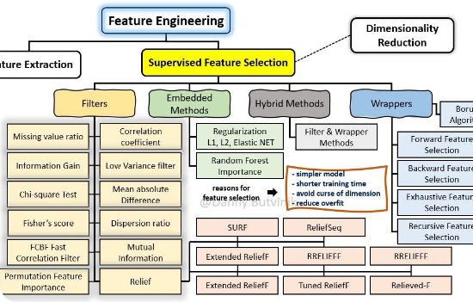
Optimization & Ranking
Ranked Importance
We reduce noise and dimensionality using statistical ranking methods to select the top 2000 features.
→
Chi-Square (\(\chi^2\)): Evaluating feature independence.
→
Mutual Information: Measuring information gain per token.
→
Result: Improved F1-score and faster inference.

Slide 9
Application Structure
Tab Name | Functionality | Key Output
📂 Data | CSV Preview & Quality Check | Star distribution bar chart
🚀 Train | Model Training (80/20 Split) | Accuracy & Training metrics
📊 Results | Comparison & Evaluation | Confusion Matrices & Top Features
🔮 Predict | Live & Batch Inference | Sentiment tags & Highlighted text

Slide 10
Model Performance
Peak Efficiency
89%
Linear SVM and Logistic Regression emerged as top performers, handling negation and bigrams with high precision across all three classes (Pos, Neu, Neg).
AVG. MACRO F1-SCORE
→
Recall: High for extreme ratings (1 & 5)
→
Precision: Excellent for negative filtering

Slide 11

Live Prediction
The interactive prediction engine provides real-time feedback with word-level highlighting.
"The food was , but the service was ."
→
Positive words in green
→
Negative words in red
→
Negation cues in bold

Slide 12
Thank You

